Slide 1

Community Conversation #1
Governance and Decision-Making
January 24, 2026
10 am to 12 noon
Facilitated by Inga Petri, Strategic Moves
Notes:
10 am

Slide 2
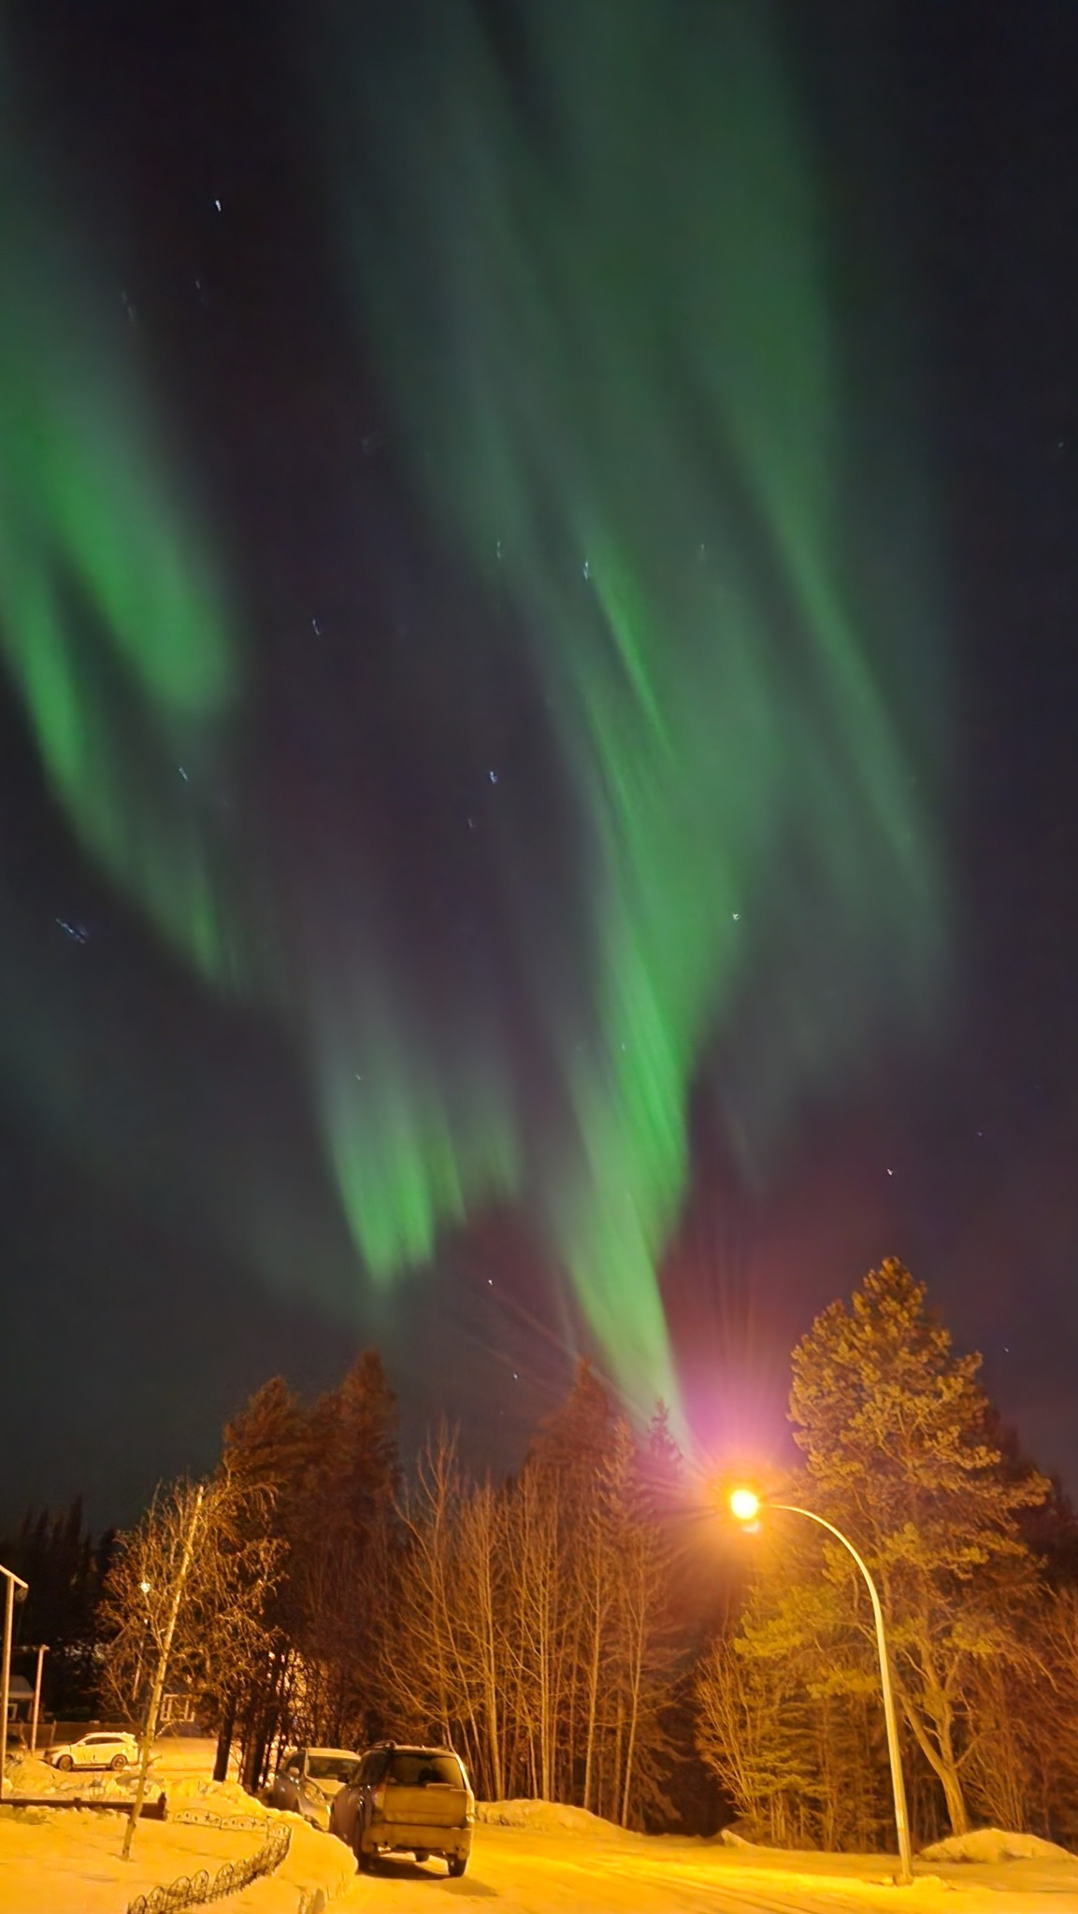
Welcome and Introductions
In the CHAT:
Your name
Where you live
Briefly, your involvement with the arts, creativity, food, culture
Notes:
10 am to 10:08 am – and dive in to content

Slide 3
Today’s Agenda
Background on imagiNorthern
2 options – the initial one and a revised one based on steering committee feedback
Small groups to discuss the options, keep notes (Google Doc) and share in full group
Community Conversation #2 on February 2, 4:30 pm Central Time
  Help shape a governance approach that is practical, meaningful, and rooted in Northern values
  Share your perspectives on how imagiNorthern should make decisions
  Talk about what feels right, what raises questions, and what needs care
  Learn from one another’s experiences across communities
Notes:
10:10

Slide 4
Who is involved
ImagiNorthern is incubated by the Flin Flon Arts Council
Steering Committee (short term)
  Andria Stephens, Carrie Hume, Claudia Grill, Debbie Howell, Ervin Bighetty, Kristy Janvier, Rhonda Head, Steven Larocque
ImagiNorthern staff
  Fiona Rettie, Project Manager
  Roy Mexted, Northern Champion Coordinator
Foods and Arts project (Creative Manitoba)
  Several locally engaged coordinators for training workshops
Consultants
  Inga Petri, Strategic Moves
  Kíwétinohk Consulting
  Darcy Penner Management Consulting (network review in 2025)
Notes:
10:11

Slide 5
Guiding Principles for Working Together Today
We are holding a conversation with people interested in artistic, creative, cultural and food practices, and interested in imagiNorthern, about how to strengthen the arts, creative and food sectors in Northern Manitoba / Northern Saskatchewan.
We recognize that we must strive to overcome historical and divisive biases, such as colonialism, racism, sexism, homophobia and transphobia, ageism and so on in society.
Listen actively – respect others when they are talking.
Share responsibility for including all voices in the conversation. Make space.
Don’t be afraid to respectfully challenge one another by asking questions but refrain from making it personal – focus on the ideas, not the person.
Participate to the fullest of your ability – community growth depends on the inclusion of every individual voice.
Share your own story and experience, instead of commenting on somebody else’s story with your own spin on their experience.
Be open to changing your perspectives based on what you learn from others.
Notes:
10:13

Slide 6
ImagiNorthern: a voice for Manitoba's northern arts community
Vision: A culturally rich and economically vibrant northern Manitoba where artists, makers, and cultural leaders drive local development, connect communities, and share their voices with the world.
Mission: To build and sustain a northern-led creative network that equips artists with the tools, spaces, and support they need to thrive—while growing local economies, strengthening cultural infrastructure, and amplifying northern stories across Canada and beyond.
Who We Want to Be
imagiNorthern is a northern-led creative network rooted in the values, voices, and leadership of northern Manitoba communities. While initially coordinated by FFAC, we are transitioning toward independence, guided by regional Champions, core organizations, and cross-sector partners. Our network includes artists, cultural workers, and food innovators committed to revitalizing community life through creativity, entrepreneurship, and collaboration. Grounded in Indigenous and northern values, reciprocal relationships and community insight, our structure is responsive, place-based, and shaped by those who live and create here.
Notes:
10:15

Slide 7
Northern Manitoba Arts and Culture Strategy
At-A-Glance
Regular Gathering
Connection
Cross-Sectoral
Arts development
Market development
Physical and Digital Infrastructure
Advocacy
Funding
Notes:
10:17

Slide 8
What We Do
Develop community-based creative spaces
Expand digital commerce platforms
Support strong local leadership
Host regional workshops and professional development
Facilitate cultural exchange and connection
Grow visibility through outreach
Support initiatives aligned with community goals
Conduct data collection and shared governance
Notes:
10:18

Slide 9
ImagiNorthern so far
2022 – Commissioned a baseline study of the arts sector in Northern Manitoba
2023 – Received initial funding from Canada Council for the Arts and Province of Manitoba to pilot ImagiNorthern, Phase 1
    Initial Northern Champions network: Flin Flon, OCN/The Pas, Churchill, Thompson, Snow Lake, Lac Brochet.
2024 – began a regional cultural asset mapping survey and supported Creative Manitoba’s new Arts Directory.
    Working with Uptown Emporium as a storefront and an e-commerce website.
    Made websites for several communities.
    Shop-in-the-Box with mobile StarLink internet
2025 – Network Development Consultation resulting in the current process
Funding gaps are filled to some degree by partnership with UCN for annual gathering (3 delivered); and with Creative Manitoba’s Food and Arts project.
https://strategicmoves.ca/reports-media/northern-manitoba-arts-and-cultural-sector-strategy
Notes:
10:20

Slide 10
ImagiNorthern evolution subject of this conversation
Governance: How decisions are made and who has what authority, responsibility, accountability.
  Clarify decision-making process
  Develop reporting relationships
  Balance formal structures with grassroots approach
  Timeline for independence from fiscal incubation by Flin Flon Arts Council (target late 2026)
As we clarify governance, we can tackle in detail
  Membership: Who is a member and what's expected of them
  Value Proposition: What benefits members receive and what collective impact the network creates
Notes:
10:22

Slide 11
Questions or comments so far?
Notes:
10:22 to 10:30

Slide 12
Two Governance Models for Discussion
Organizations as Members
Individual and organizations as Members
Notes:
10:31

Slide 13
Local decision-making, regional support
ImagiNorthern is framed as a regional initiative that recognizes and supports the need for local decision-making and that is led by northern Manitoba communities
  Ensure local representation
  Avoid perceptions of conflicts of interest
  Create legitimacy as a regional network through local member-led governance control
Notes:
10:32

Slide 14
Option 1 ― Organizations as Core Members
Proposed Roles
Individual Artists: End users and beneficiaries of the network; gain access to infrastructure, training, and opportunities.
Core Members: Arts and food organizations north of the 53rd parallel who appoint board members and nominate local champions, provide continuity, and offer local insight.
ImagiNorthern Board Members ($250 per meeting, max $1,000 annually): Appointed by Core Members for two-year terms; participate in board meetings and make strategic decisions.
Local Champions (paid staff): Nominated by Core Members, hired and contracted by imagiNorthern to support local programming and lead data collection.
Paid Staff: Project Manager and Champion Coordinator hired by the board. Oversee operations, strategy execution, budgeting, and support Champions and board administration.
Partners: Organizations with shared values; work collaboratively with imagiNorthern via MOU or agreements, e.g. UCN, Creative Manitoba, Manitoba Legal Clinic for the Arts, etc.
Advisors: Individuals with regional or thematic expertise; provide insight and attend meetings as needed (non-voting).
Associates: Informal contributors such as tourism companies or marketing agencies.
Notes:
10:32

Slide 15







Option 1 ― Organizations as core members
Major responsibilities for appointment to board and nominating local champions
Core member organizations
Nominate or Appoint ImagiNorthern Board members
Hires
Project mgr
Champion Coordinator
Partners (MOU)
Advisors
Associates
Hiring Committee Project mgr, champion coordinator, non-local board member
Nominate 3 potential Local Champion staff
Hires local champions
Local champions work in home communities; supported by regional coordinator and local core members
Notes:
10:35

Slide 16
Option 1 ―
Draft Organizational Structure for current 2-headed organization
Core Members = Local Organizations
imagiNorthern Board of Directors
appointed by local member organizations (unclear how many board members)
Hiring Cttee
Other Committees
Project Manager
Champion Coordinator
Local Champions
Notes:
10:37

Slide 17
Steering Committee liked …
Core principles emphasized:
  Decisions must clearly reflect the interests, priorities, and lived realities of their local northern communities
  Avoid repeating past models where at times:
    affected communities were not meaningfully involved in important decisions,
    local connections with the local arts communities were not sufficient to do the work envisioned
Local member organizations not making final hiring or firing decisions for local champions
  Helps avoid personal conflicts in small communities
Board and staff balance local knowledge and regional action
No overlap between board members, ImagiNorthern staff/local champions
Notes:
10:38

Slide 18
But Steering Committee had practical concerns …
Concern that the structure may be too complex and too heavy a workload for northern grassroots initiatives
  The model could advantage places with established organizations and leave behind communities without that already established capacity
  Capacity-building implication that imagiNorthern may need to actively support the development of arts organizations, arts infrastructure, leadership pathways in communities currently lacking them
Concerns about how workable this model is in smaller northern communities where:
  relationships are close and overlapping
  “professional separation” is hard to maintain
  hiring/appointments could be complicated by existing local dynamics
Notes:
10:39

Slide 19
Steering Committee had practical concerns …
If core member organizations appoint board member – does that mean those board members are “representatives” of the local organization on the board?
If there is no organization that wants to be a member in a community, does that mean there won’t be a local champion?
If there are several member organizations in a community who makes those nominating or board appointment decisions
  Would they have to work together to work that out? How much work? Practical?
What qualifies an organization to become a core member
How can we ensure diversity of skills on the board in this system?
Notes:
10:40

Slide 20
Who exactly should be members and what are their rights / obligations?
a network of organizations
a network of people + organizations?
Notes:
10:42

Slide 21
Questions or comments so far?
Notes:
10:45

Slide 22
Alternative Governance structure based on Steering Committee input
It keeps the core values people agreed on, while addressing real-world capacity, fairness, and workability issues across Northern communities.
Notes:
10:48

Slide 23
Reduce structural complexity
Option 1 placed significant responsibility on local organizations (appointments, nominations, coordination).
Option 2 simplifies governance so communities can participate without needing formal organizational infrastructure.
Avoid “capacity gaps” and black holes
Option 1 risked excluding communities with strong cultural activity but no arts or food organizations.
Option 2 allows individuals and organizations to be members, ensuring communities are not left out because of current capacity.
Clarify board accountability
Option 1 raised confusion about whether board members were representing their organization or the network.
Option 2 makes it explicit: board members act in the best interest of imagiNorthern as a whole, not as delegates of a local organization.
Make recruitment and hiring more transparent and fair
Option 1 relied heavily on nominations through organizations, which raised concerns in small communities with overlapping relationships.
Option 2 uses open calls, defined competencies, and mixed hiring committees, reducing bias and pressure on local relationships.
Model that can grow with the network
Option 2 is designed to work now, with current capacity, and still adapt as communities, leadership, and infrastructure grow over time.
Notes:
10:50

Slide 24
Option 2 ―
Alternative Organizational Structure with Mixed membership, defined board and Executive Director
Members – Individuals and Organizations
imagiNorthern Board of Directors
Specific requirements, mix of skills and expertise
Executive Director
Champion Coordinator
Local Champions
Financial & Administrative manager
(book keeper & grant writer)
Notes:
10:52

Slide 25






Option 2 ― Individuals and Organizations as members
Simplified recruitment process; open job postings
Membership
Individuals and Orgs
Elects
ImagiNorthern Board members
Hires
Executive Director
Partners (MOU)
Advisors
Associates
Job postings
Hiring Committee Executive Director
Champion Coordinator
Non-local board member
Local Community member
Consulted on leads for potential Local Champion staff
Hires Champion Coordinator and local champions
Local champions work in home communities; supported by regional coordinator and local core members
Notes:
10:58

Slide 26
How option 2 is different
Membership becomes inclusive and flexible
  imagiNorthern becomes a network of people and organizations, not only organizations.
  Membership can include:
    Individual artists, makers, food producers, knowledge keepers
    Community leaders and cultural workers
    Arts, food, Indigenous, and community organizations
  This ensures:
    Communities without formal organizations are not excluded
    Indigenous participation is not dependent on incorporation status
    Governance reflects lived reality, not paperwork
Board roles are clearer and more accountable
  Board members are:
    Elected by the membership, not appointed by organizations
    Accountable to imagiNorthern’s mission, values, and bylaws
  Board composition can intentionally balance:
    Regional representation
    Indigenous leadership
    Functional expertise (e.g. finance, legal, HR, governance)
  Clear accountability and removal mechanisms protect the organization if board members do not act in the network’s best interest.
Notes:
11

Slide 27
How option 2 is different
Decision-making authority is clearly defined
  Board: strategic direction, budgets, policies, major commitments
  Executive Director: operational leadership, staff oversight, implementation
  Staff and coordinators: delivery of programs and community engagement
  Members and community: input, feedback, learning, and direction-setting through conversations and gatherings
  This reduces confusion about:
    Who decides what
    When consultation is required
    When decisions need to move forward efficiently
Governance becomes adaptive, not fixed
  Option 2 recognizes that:
    No single structure will be perfect for every community
    Governance must evolve as relationships, trust, and capacity grow
  The model allows for:
    Review and adjustment
    Interim appointments if elections don’t produce enough candidates
    New membership categories or roles as needed
Notes:
11:02

Slide 28
How option 2 is different
Hiring and staffing become more workable in small communities
  Hiring is open and transparent, rather than dependent on local organizations’ networks.
  Hiring is done through mixed committees (Executive Director + non-local board member + local community member).
    Reduces pressure on local relationships
    Avoids conflicts of interest
    Still honours local knowledge and context
Importantly, in both options
Champions are supported, not isolated
  Work in their home communities
    Listen to needs
    Works to build local capacity
  Supported by:
    A regional coordinator
    Clear reporting tools (e.g. Creative Pulse)
    Defined expectations that can scale over time
Notes:
11:04

Slide 29
Small Groups – 25 minutes – Please take notes in the Google docs provided – find your group number
Who should be members of imagiNorthern?
How are the proposed governance approaches either a burden or opportunity for local organizations?
How should the board of directors be formed?
Practical ways to engage local people / organizations in hiring for local champions?
How best to organize local and regional decision-making?
Anything else that is on your mind?
Notes:
11:08 to 11:35

Slide 30
Report back on your discussion
I will share summary notes from your conversations with this group and anyone who has RSVP’d to the next community conversation on February 2.
Go to imaginorthern.ca to RSVP
Share this information with your own friends, colleagues, networks
Notes:
11:35 to 11:55 I might set up some polls to aid reporting back re; who should be members, etc.
Close by 12

